Slide 1
Medication Management and Error reduction system (Milestone 2.0)
By Ben Morehead, Jade Sleiman, and Mark Villamayor

Slide 2
Problem Statement & Project Goals Recap
To reiterate...
We aimed to...
Every year, medication errors cause significant morbidity and mortality. At least one death every day and 1.3 million people are affected annually in the United States according to FDA.
Reduce Medication Errors - Implement real time alerts to prevent dispensing errors.
Enhance Medication Management - Providing a comprehensive dashboard for monitoring and alerts on patient medication schedules.
Improve Shared Information - Enable access to updated medication information and interaction warnings.

Slide 3
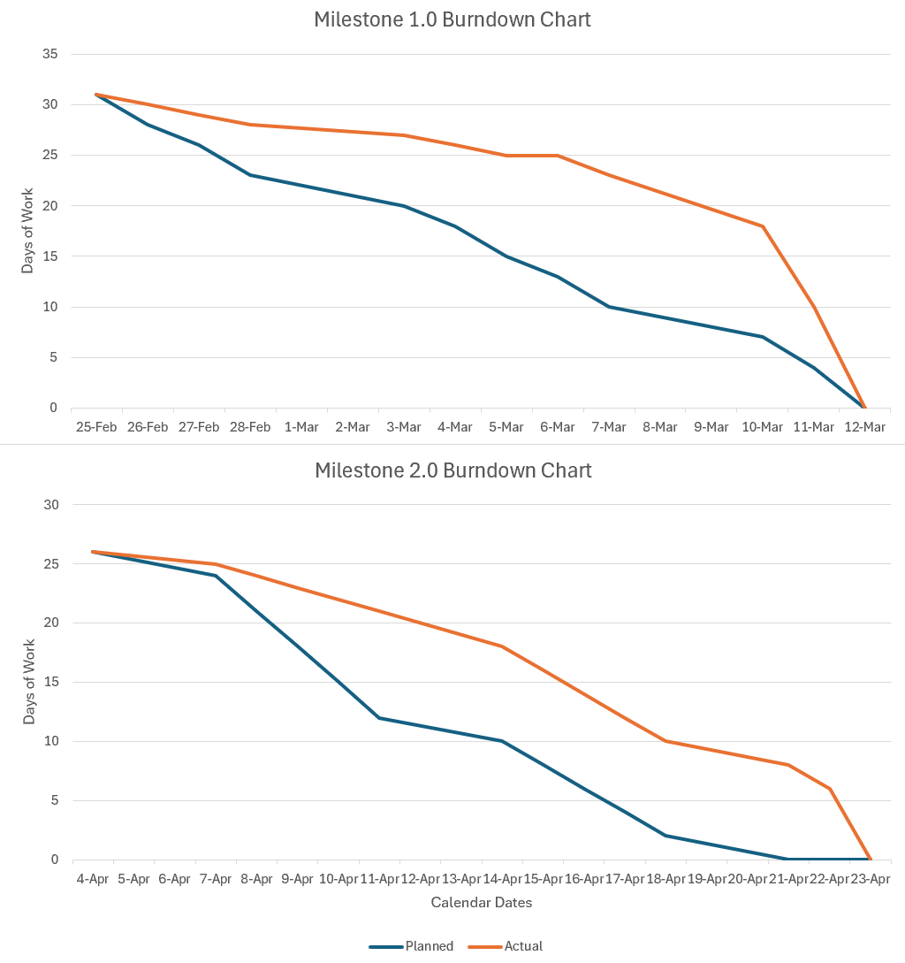
Agile Methodology
Adaptive Project Framework (APF)
Emphasizes flexibility amidst changing circumstances (individual timeline shifts, sudden team changes, needs matching existing knowledge pool, etc.)
Prioritizes important functionality over comprehensive functionality

Slide 4
System Architecture Overview
Backend: Flask API, MySQL Database
Frontend: React Application
External API Integration: openFDA

Slide 5
Project Features
Milestone 1.0
Milestone 2.0
Drug Interaction Checker
Real-time identification of potentially dangerous drug combinations
Integration with openFDA API for authoritative medication data
User-friendly interface for quick medication entry and results
Error Handling Framework
Robust error management for API failures and network issues
Clear user feedback when medications aren't found in database
Graceful degradation to ensure system remains functional
Basic User Interface
Simple, intuitive web interface for healthcare providers
Responsive design that works across different devices
Clear presentation of interaction information
Enhanced Security Features
Two-factor authentication for provider access
Role-based permissions for different healthcare staff
Secure storage of patient medication histories
Prescription Management System
Barcode scanning integration for medication verification
Automated alerts for prescription errors
Digital signature capability for e-prescriptions
Advanced Analytics Dashboard
Medication error tracking and reporting
Trend analysis for common interaction issues
Provider-specific metrics for quality improvement
Patient Portal Integration
Patient-friendly medication information
Personalized interaction warnings
Medication adherence tracking and reminders

Slide 6
Stakeholders & Benefits
Patients
Medical Providers
Administrators

Slide 7
Live Demo

Slide 8
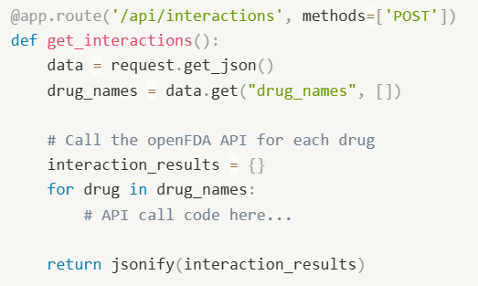
API Endpoint (/api/interactions)
Here's our API endpoint that handles drug interaction checks. It's a POST endpoint that accepts a JSON payload containing an array of drug names. We chose POST rather than GET because it allows us to send multiple drug names in the request body, which is more flexible than query parameters.

Slide 9
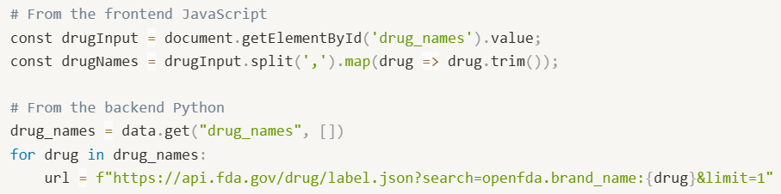
How the Application Processes Drug Names
Our application processes drug names in two steps. First, on the frontend, we take the comma-separated input from the user, split it into individual drug names, and trim any whitespace. Then, on the backend, we iterate through each drug name and construct a query to the openFDA API, specifically searching by brand name in the drug labeling database.

Slide 10
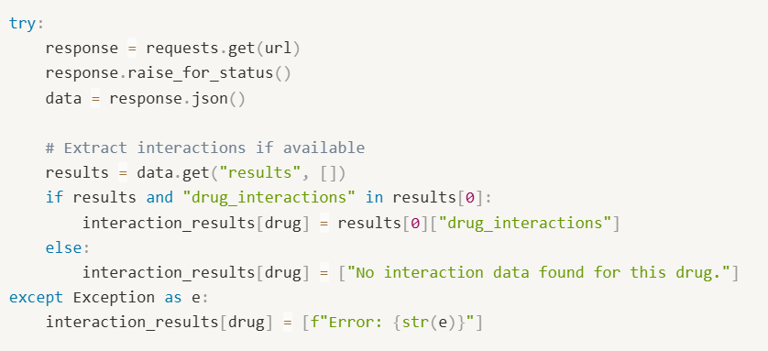
How It Handles API Responses
"Our application handles API responses with careful error management. We use a try-except block to catch any issues with the API call itself. Once we get a response, we check if there are results and if those results contain drug interaction information. If interaction data is found, we store it in our results dictionary. If not, we provide a clear message that no interaction data was found. This robust error handling ensures our application degrades gracefully when faced with API issues or missing data."

Slide 11
Testing Approach
Notes:
"aspirin, warfarin" (common blood thinners that interact)
"lisinopril, spironolactone" (blood pressure medications)
"metformin, glipizide" (diabetes medications)

Slide 12
Multi-layered Testing Strategy
Unit tests for core functionality components
Integration tests for API connections and data flow
End-to-end tests for complete user workflows
Test-Driven Development
Writing tests before implementation to ensure requirements are met
Continuous testing throughout development lifecycle
Automated test execution with each code change
User Experience Testing
Simulated clinical scenarios with realistic medication combinations
Usability testing with healthcare provider feedback
Performance testing under various network conditions

Slide 13
Specific Test Implementations
Drug Interaction API Tests
Verify correct interactions returned for known drug combinations
Test handling of medications not found in database
Validate error responses for malformed requests
User Interface Tests
Confirm form validation for medication input
Test responsiveness across different screen sizes
Verify clear presentation of interaction warnings
Error Handling Tests
Simulate API failures and verify graceful degradation
Test timeout scenarios and retry mechanisms
Validate helpful error messages displayed to users
Coverage Metrics
Achieved 85% code coverage for core interaction logic
Implemented pytest-cov for detailed coverage reporting
Prioritized testing of critical patient safety features

Slide 14
Implementation details
API Integration Architecture: Implemented RESTful endpoint (/api/interactions) that processes medication lists and connects to the openFDA drug labeling database using asynchronous requests to ensure responsive performance.
Error Handling Framework: Developed robust error management system that gracefully handles API failures, medication not found scenarios, and malformed requests while providing meaningful feedback to healthcare providers.
Clinical Workflow Design: Structured the application to support point-of-care decision making with minimal friction, allowing providers to quickly identify potential medication conflicts before finalizing prescriptions.
Notes:
Talking Points for Drug Interaction Checker Presentation
1. How the Application Helps Prevent Medication Errors
"Our drug interaction checker directly addresses a critical healthcare problem: medication errors that cause harm to patients. According to the FDA, medication errors result in at least one death every day and affect 1.3 million people annually in the United States.
This application helps prevent these errors by:
Providing real-time identification of potentially dangerous drug combinations before they're prescribed
Giving healthcare providers immediate access to interaction information at the point of care
Reducing the cognitive burden on busy medical providers who can't memorize all possible drug interactions
Creating a safety net that catches dangerous combinations that might otherwise be missed
Empowering both providers and patients with knowledge about medication risks"
2. How it Connects to the openFDA API
"Our application leverages the power of the FDA's own data through their openFDA API:
When you enter medication names, our application sends a request to the openFDA API for each medication
We specifically query the drug labeling database using the brand name as a search parameter
The API returns comprehensive information about each drug, including officially documented interaction warnings
Our application extracts the 'drug_interactions' field from the response, which contains FDA-approved warnings
We handle various edge cases, such as medications not found in the database or network connectivity issues
This approach ensures we're using authoritative, up-to-date information directly from the FDA rather than maintaining our own potentially outdated database"
3. How This Would Integrate with a Prescription System
"In a full healthcare setting, this interaction checker would be seamlessly integrated into the prescription workflow:
When a provider begins creating a new prescription, the system would automatically check it against all of the patient's current medications
Before a prescription can be finalized, any potential interactions would trigger an alert requiring provider acknowledgment
The severity of interactions would be color-coded (red for severe, yellow for moderate, green for mild)
Providers could click on any interaction warning to see detailed information about the mechanism of interaction and recommended alternatives
The system would maintain a log of all interaction warnings and provider responses for quality assurance and liability protection
For hospital settings, this would integrate with the medication dispensing system to provide an additional safety check
Patients would receive printouts of potential interactions along with their medication instructions
This integration creates multiple layers of protection against medication errors, potentially saving lives and reducing adverse events."
Closing Statement
"By implementing this drug interaction checker, we're addressing a significant healthcare problem with a practical, user-friendly solution. The application demonstrates how technology can be leveraged to improve patient safety and support healthcare providers in delivering better care. This feature is just one component of our comprehensive medication management system, but it represents a critical safety feature that directly impacts patient outcomes."

Slide 15
Future possible work
Enhanced Clinical Decision Support
Severity classification for drug interactions
Alternative medication recommendations
Integration with patient-specific factors (age, weight, conditions)
Expanded Data Sources
Additional pharmaceutical databases beyond openFDA
Integration with hospital formulary systems
Real-time updates from pharmaceutical manufacturers
Mobile Application Development
Native iOS and Android apps for healthcare providers
Offline functionality for areas with limited connectivity
Barcode scanning using mobile device cameras
Machine Learning Integration
Predictive analytics for potential adverse events
Personalized risk assessment based on patient history
Pattern recognition for identifying medication error trends
Interoperability Enhancements
FHIR standard compliance for healthcare system integration
Direct EHR integration via API
Health Information Exchange (HIE) connectivity

Slide 16
Q&A
Questions?
Comments?
Concerns?

Slide 17
How accurate is the openFDA data?
"The openFDA data is highly reliable as it comes directly from FDA-approved drug labeling, which undergoes rigorous scientific and regulatory review. However, it does have some limitations:
It only includes interactions that have been formally documented in FDA-approved labeling
There can be a lag between new research findings and updates to official labeling
The data focuses on known pharmacological interactions but may not capture all real-world patient experiences
Some interactions may be theoretical or based on class effects rather than direct evidence
For a production system, we would consider supplementing the openFDA data with additional sources like DrugBank or Micromedex for more comprehensive coverage. We would also implement a regular validation process to ensure our interaction checks align with current clinical guidelines."

Slide 18
How would you handle medications not found in the database?
"We've implemented several strategies to handle medications not found in the database:
First, our error handling already provides a clear message when no data is found
In a production version, we would implement fuzzy matching to handle misspellings or alternative names
We would expand our search to include both brand names and generic names (currently we only search by brand name)
For medications truly not in the database, we would flag them for manual review
We would maintain a local cache of common medications to reduce dependency on the API
For new or experimental medications, we would implement a secondary workflow to check for interactions based on drug class rather than specific medication
This multi-layered approach ensures we provide useful information even when the primary data source doesn't have a specific medication."

Slide 19
How would you improve the user interface for healthcare providers?
"For healthcare providers, efficiency and clarity are paramount. We would enhance the UI in several ways:
Integration with electronic health records to automatically pull the patient's current medication list
Color-coding interactions by severity (red for severe, yellow for moderate, green for mild)
Adding a filtering system to prioritize clinically significant interactions
Providing specific recommendations for each interaction (e.g., 'Monitor blood pressure daily' or 'Consider alternative medication')
Adding a timeline view to show when interaction risks might occur during treatment
Implementing a mobile-responsive design for use on tablets during rounds
Adding the ability to print patient-friendly interaction summaries
Including a one-click function to document that the provider has acknowledged the interaction risk
These improvements would make the tool more valuable in clinical workflows while maintaining the simplicity that makes it quick to use."

